Slide 1


PN-IV-P6-6.1-CoEx-2024-0141
Societal impact zone; 4.5 New tools technologies and digital solutions for a healthy society

Slide 2
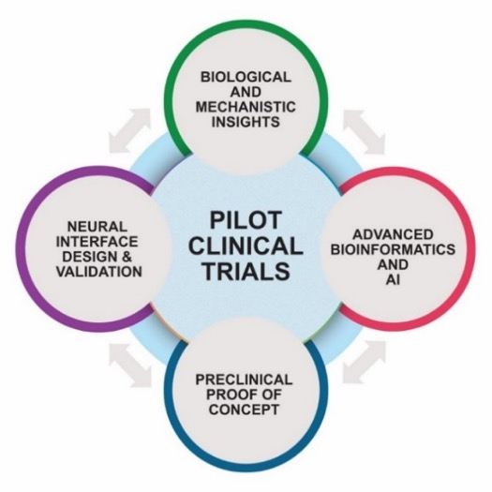
Aim: to harness and integrate cutting-edge technological advancements in neuropathology, genetics/epigenetics, neuro-engineering and artificial intelligence, intertwining next generation novel and state-of-the-art pre-clinical models and clinical trials to unlock new avenues of translational research with measurable positive impact on the diagnosis, prognosis and treatment of neurological conditions

Slide 3
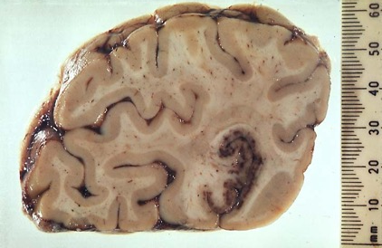
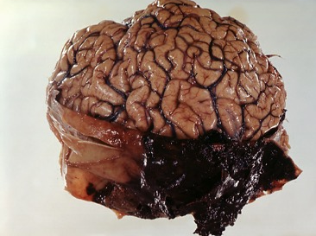
Rationale
Neurological diseases represent the single most major cause of disability in the world and the third in Europe (after cardiovascular diseases and cancer)
No national dementia strategy and 600,000 living with dementia in Romania
Cost of ALS treaments in Romania is highest in Europe
CNS tumours (14%) top the cancer diagnosis of the Romanian pediatric population with highest mortality rate in Europe
TBI is the main cause of death in people under 40 years old, incidence: 300 cases /100,000 citizens. Every 8 minutes a Romanian has a TBI.
Romania has one of the highest incidences of stroke and highest mortality rate due to brain haemorrhages in Europe.

Slide 4






Partners
Grigore T. Popa University of Medicine and Pharmacy Iași through Advanced Center of Research-Development in Experimental Medicine (CEMEX)
Transylvania University of Brașov
"Victor Babeș" National Institute of Pathology, Bucharest
"Iuliu Hatieganu" University of Medicine and Pharmacy Cluj-Napoca,
Emergency County Clinical Hospital Târgu Mureș

Slide 5
Key persons: Roxana Carare, Irina Mohorianu, Mark Slevin, Romeo Racz
Management of project: Nicoleta Suciu
Scientific Council: Kevin O’Neill (neurosurgery), Raj Kalaria (neuropathology), Britta Englehardt (neuroimmunology),
Mo Al’Onaizi (neuro metabolism)
Mentors: Ajay Verma (biotechnology, industrial partner), Stefano Pluchino (bioinformatics).

Slide 6
Objective 1:Assessment of Unmet Needs in common neurodegenerative and neurovascular diseases including head injury.
All partners participate
Biological: retrieval and cross-assessment of sequencing and imaging high throughput datasets
Engineering: literature review of engineering-driven approaches for targeted delivery of drugs.
Computational: leading to a scalable and generalizable framework permitting the integration of heterogeneous sequencing and imaging data ;AI/ML-driven identification of common patterns and specific differences for major disease models.

Slide 7

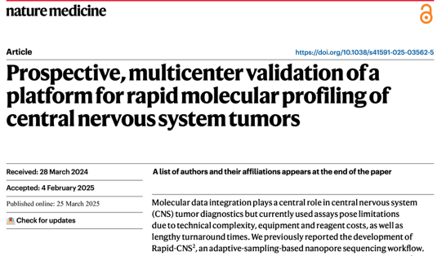
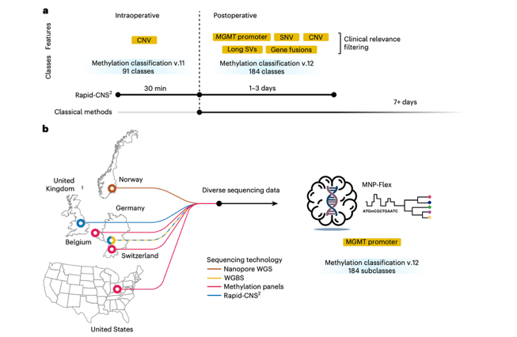
Neurological diseases across the lifespan
Young brains: Paediatric brain tumours
Adults: TBI, Multiple Sclerosis, Parkinson’s disease
Aged brains: Alzheimer’s disease

Slide 8
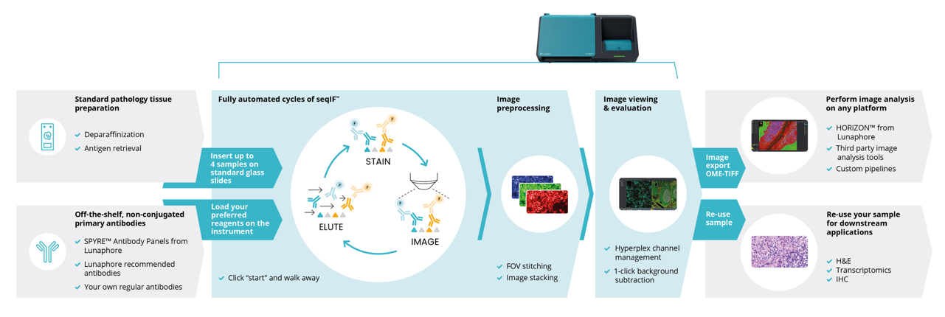
Objective 2: Creation of a national and multi-national clinical trials centre and co-ordination of cross centre neurological investigations
Clinical: Creation of NeuRoBank: blood, CSF, tissue (surgical, postmortem).
Biological: Novel biomarkers. Pre-market evaluation of new potential therapeutics and pharmacologics.

Slide 9

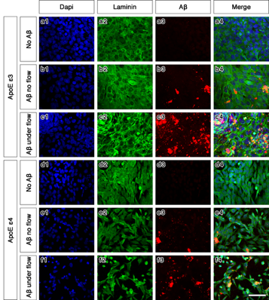
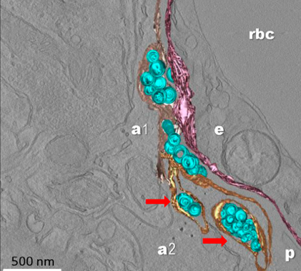
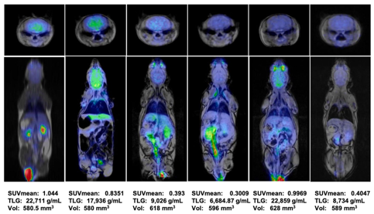
Objective 3: Pre-clinical development, modelling, interpretation

Slide 10
Example: development of new preclinical models such as organoids
for testing biomarkers and new therapeutics in dementia

Slide 11
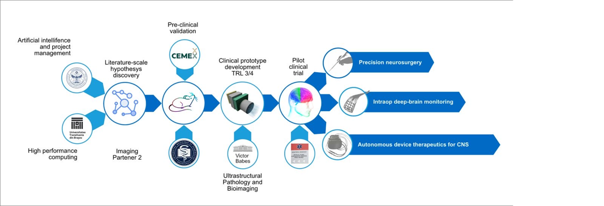
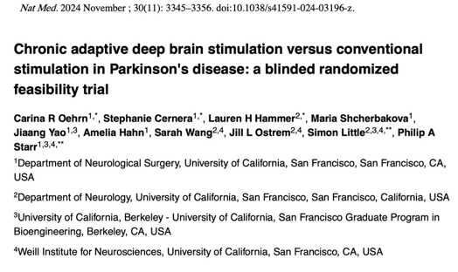
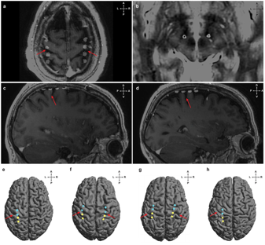
Objective 4. Enhancing Neurotechnology with Advanced Devices

Slide 12
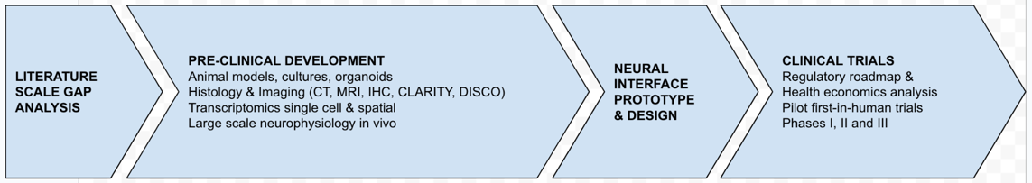
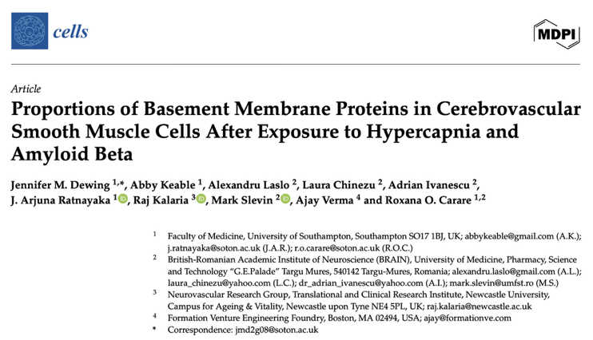
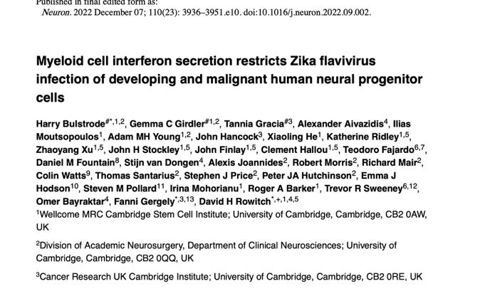

Slide 13
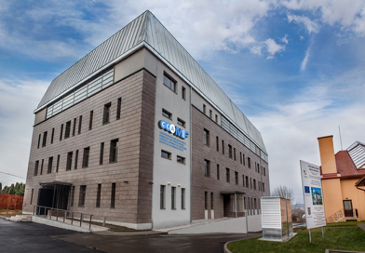
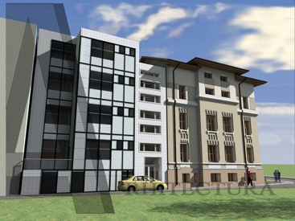
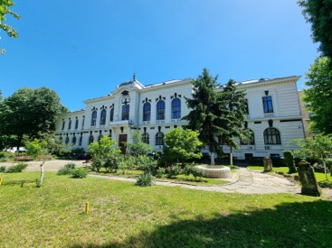
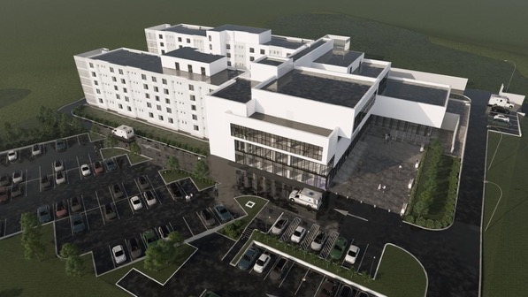

NeuRoX drives innovation to improve brain health and restore hope
NeuRoX: where the first efficient cure for a neurological disease has been discovered

